Slide 1


Crabtree, Rohrbaugh & Associates
MONTOURSVILLE AREA
SCHOOL DISTRICT
DISTRICT WIDE
FACILITY STUDY
July 15 & 29, 2020

Slide 2
ELEMENTARY SCHOOL OPTIONS

Slide 3
OPTIONS 1 & 2
Maintains existing Elementary school buildings and grade configuration
Renovations/Additions to Loyalsock Valley ES
Renovations to Lyter ES
OPTION 3
Maintains existing Elementary grade configuration
Consolidate grades K-4 to Lyter with additions and renovations
Close Loyalsock Valley ES
OPTIONS 4 & 5
Creates grades 3-5 Intermediate School at C.E. McCall Middle School with additions
Creates grades K-2 Primary School at either Lyter or Loyalsock Valley ES
Renovations to K-2 school and additions in Loyalsock Valley option
OPTION 6
Convert Lyter ES to centralized grades K-2 Primary school with renovations
Convert Loyalsock Valley ES to centralized 3-4 Intermediate school with renovations & additions
OPTION 7
Construct new Centralized grades K-4 Elementary School on C.E. McCall Middle School site
Close Loyalsock Valley ES & Lyter ES

Slide 4
OPTION 1
Comprehensive Renovations and minor additions to Loyalsock Valley Elementary School
Mechanical, Electrical and Plumbing system upgrades to Lyter Elementary School.
Maintain current grade configuration.

Slide 5
OPTION 1
CAPACITY

Slide 6
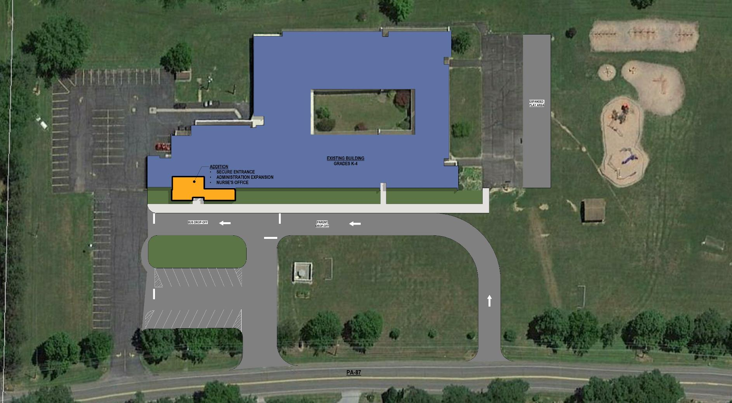
LOYALSOCK VALLEY ES FLOOR PLAN
OPTION 1

Slide 7
OPTION 1
ESTIMATED COSTS

Slide 8
OPTION 1
Pros
Lower construction costs.
Maintains neighborhood schools.
Cons
Does not address all educational functional needs at Loyalsock Valley Elementary School.
Does not address all existing facility conditions or educational/functional deficiencies at Lyter Elementary School.
Lack of equity and shared resources among grade levels.
Not as operationally efficient as other Options.

Slide 9
OPTION 1
Estimated Significant Savings
No Savings with this option.
Estimated Tax Increase Needed to Support Project
Borrowing $15 Million and up to $1 Million from Capital
.14mills
.15mills
.15mills
.15mills
.15mills
Total .74mills (This is in addition to any increase needed for operations.)

Slide 10
OPTION 2
Comprehensive renovations and major additions to Loyalsock Valley Elementary School
Mechanical, Electrical and Plumbing system upgrades to Lyter Elementary School.
Maintain current grade configuration.

Slide 11
OPTION 2
ELEMENTARY CAPACITY

Slide 12
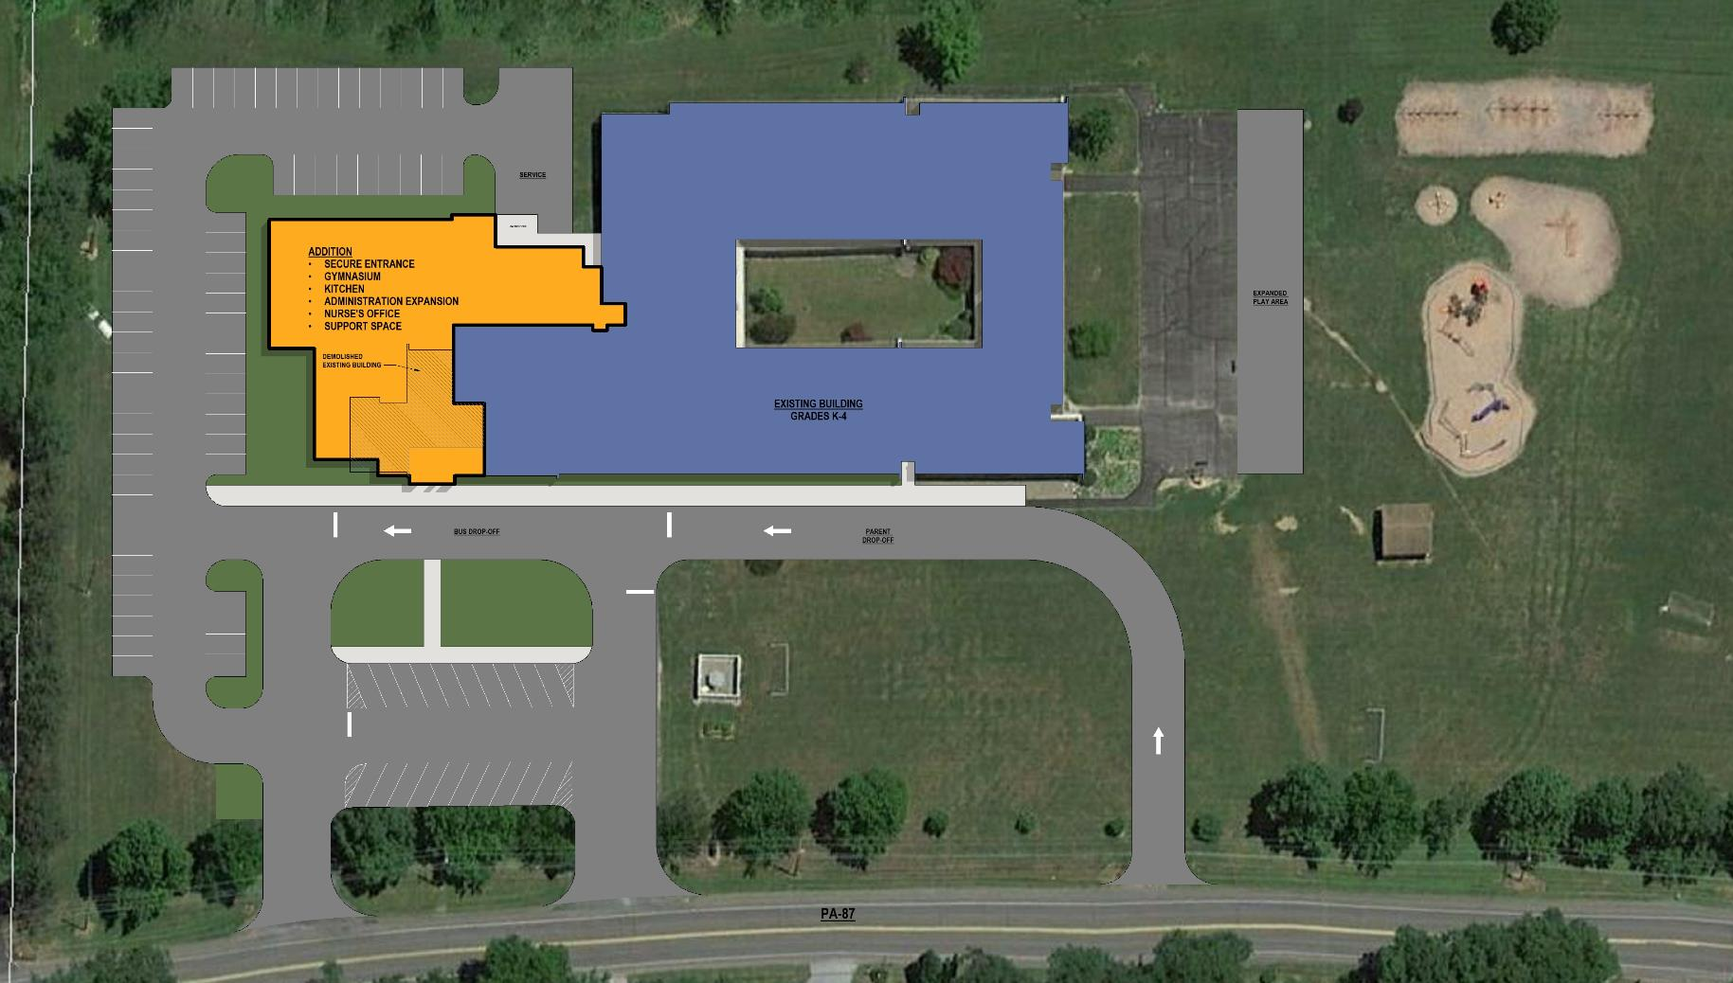
LOYALSOCK VALLEY ES FLOOR PLAN
OPTION 2

Slide 13
OPTION 2
ESTIMATED COSTS

Slide 14
OPTION 2
Pros
Meets all educational and functional needs at Loyalsock Valley Elementary School.
Maintains existing neighborhood schools.
Cons
Does not address all existing condition or educational and functional deficiencies at Lyter Elementary School.
Not as operationally efficient as other Options.
Lack of equity and shared resources among grade levels.

Slide 15
OPTION 2
Estimated Significant Savings
No Savings with this option.
Estimated Tax Increase Needed to Support Project
Borrowing $20 Million
.20mills
.20mills
.20mills
.19mills
.19mills
Total .98mills (This is in addition to any increase needed for operations.)

Slide 16
OPTION 3
Close Loyalsock Valley Elementary School
Consolidate to Lyter Elementary School.
Comprehensive Renovations and Additions to Lyter Elementary School.
Maintain current grade configuration.

Slide 17
OPTION 3
ELEMENTARY CAPACITY

Slide 18
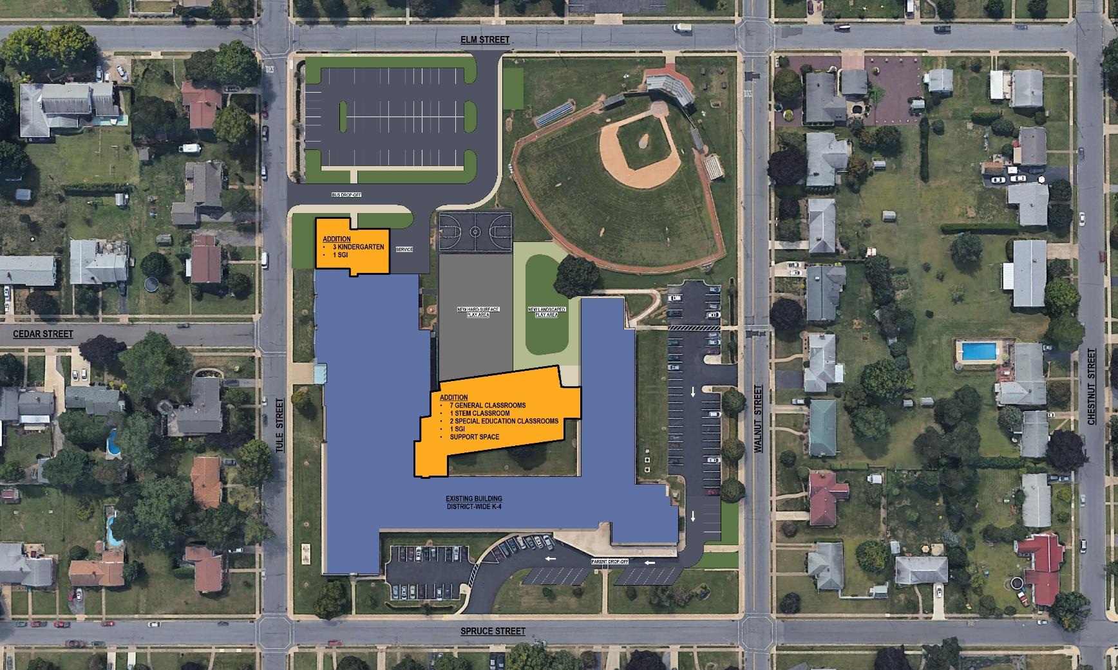
OPTION 3
LYTER ES FLOOR PLAN

Slide 19
OPTION 3
ESTIMATED COSTS

Slide 20
OPTION 3
Pros
Lower construction costs.
Equity and shared resources among grade levels.
Consolidates district to three buildings creating operational savings.
Cons
Large number of students on a condensed site.
Increase in transportation time for some Elementary students.
Loss of one neighborhood school.

Slide 21
OPTION 3
Estimated Significant Savings
Personnel $290,000
Maintenance & Utilities $110,000
$400,000
Estimated Tax Increase Needed to Support Project with Savings
Borrowing $15 Million with $300,000 savings and up to $2 Million from Capital
.07mills
.07mills
.07mills
.07mills
.08mills
Total .36mills (This is in addition to any increase needed for operations.)

Slide 22
OPTION 4
Close Loyalsock Valley Elementary School
Convert Lyter Elementary School to district wide K-2 Primary School
Comprehensive renovations to Lyter Elementary School
Construct additions to C.E. McCall Middle school for grades 3-4.

Slide 23
OPTION 4
ELEMENTARY CAPACITY

Slide 24
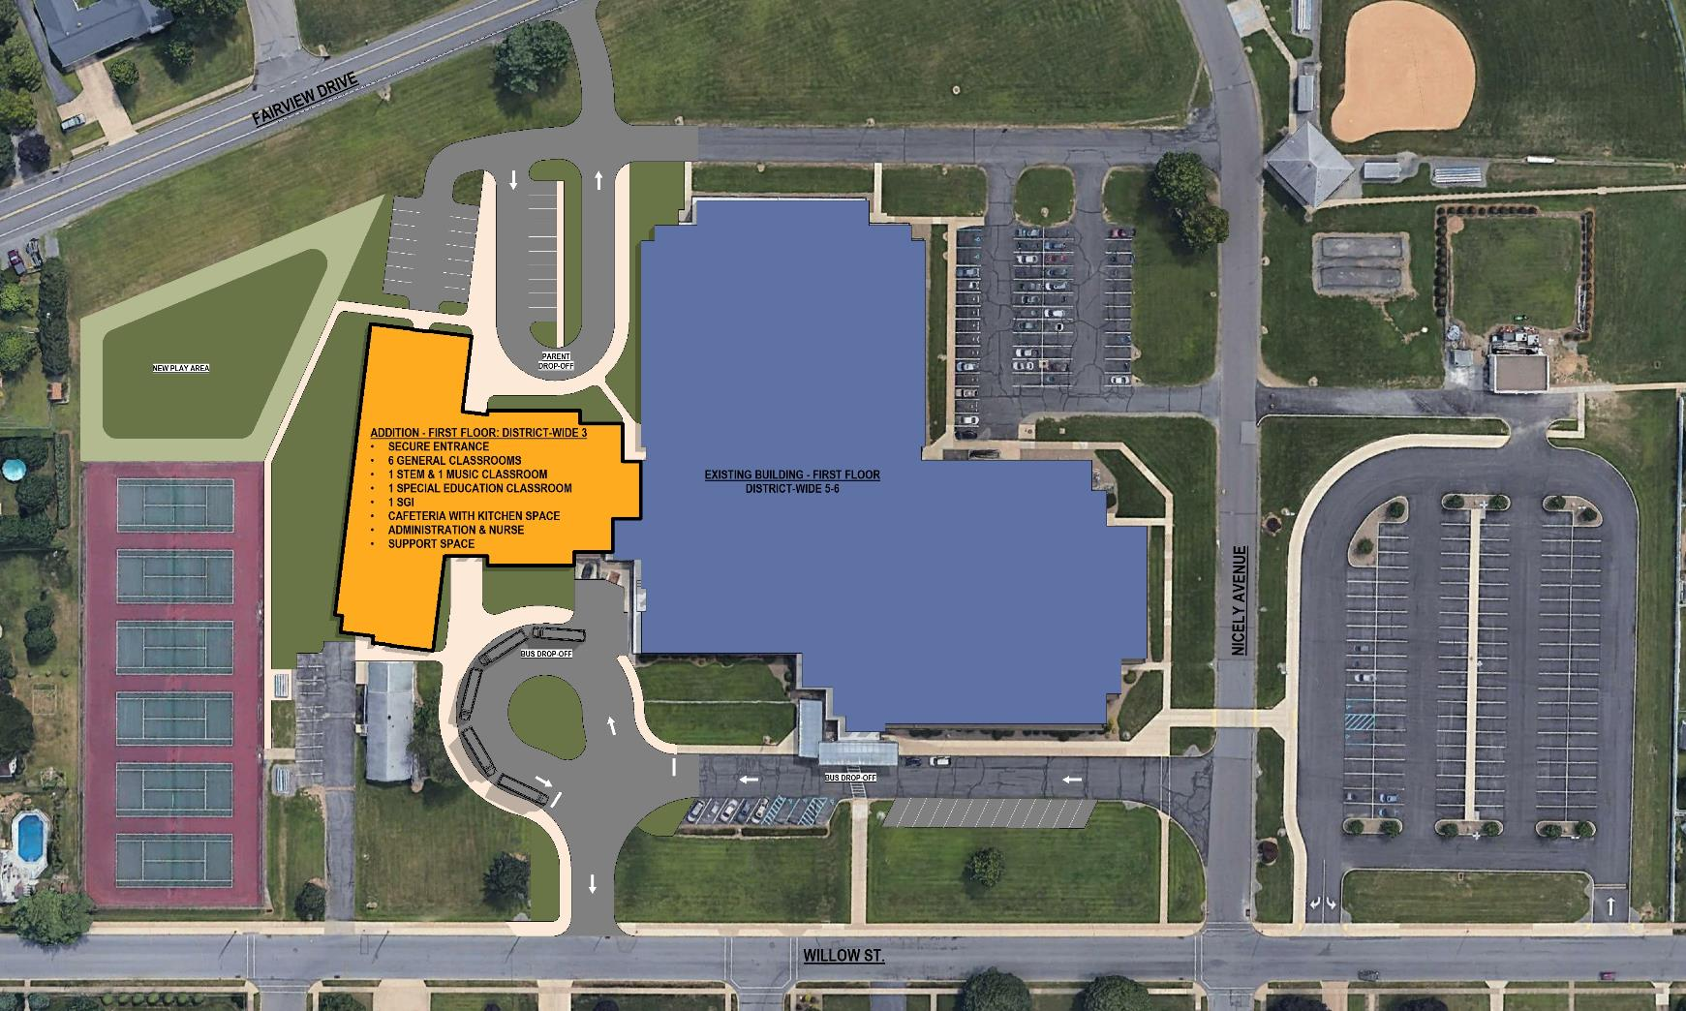
C.E. McCALL FLOOR PLAN
OPTION 4

Slide 25
OPTION 4
ESTIMATED COSTS

Slide 26
OPTION 4
Pros
Grade groupings align with educational program and goals.
Incorporates 5th grade into an appropriate Elementary grade grouping.
Equity and shared resources among grade levels.
Consolidates district to three buildings creating operational savings.
Cons
3rd and 4th grades located at Middle School.
Increase in transportation time for some Elementary students.
Loss of one neighborhood school.

Slide 27
OPTION 4
Estimated Significant Savings
Personnel $240,000
Maintenance & Utilities $110,000
$350,000
Estimated Tax Increase Needed to Support Project with Savings
Borrowing $20 Million with $200,000 savings and up to $4.2 Million from Capital
.14mills
.14mills
.15mills
.15mills
.15mills
Total .73mills (This is in addition to any increase needed for operations.)

Slide 28
OPTION 5
Close Lyter Elementary School
Convert Loyalsock Valley Elementary School to district wide K-2 Primary School
Comprehensive renovations and major additions to Loyalsock Elementary School
Construct additions to C.E. McCall Middle school for grades 3-4.

Slide 29
OPTION 5
ELEMENTARY CAPACITY

Slide 30
C.E. McCALL FLOOR PLAN
OPTION 5

Slide 31
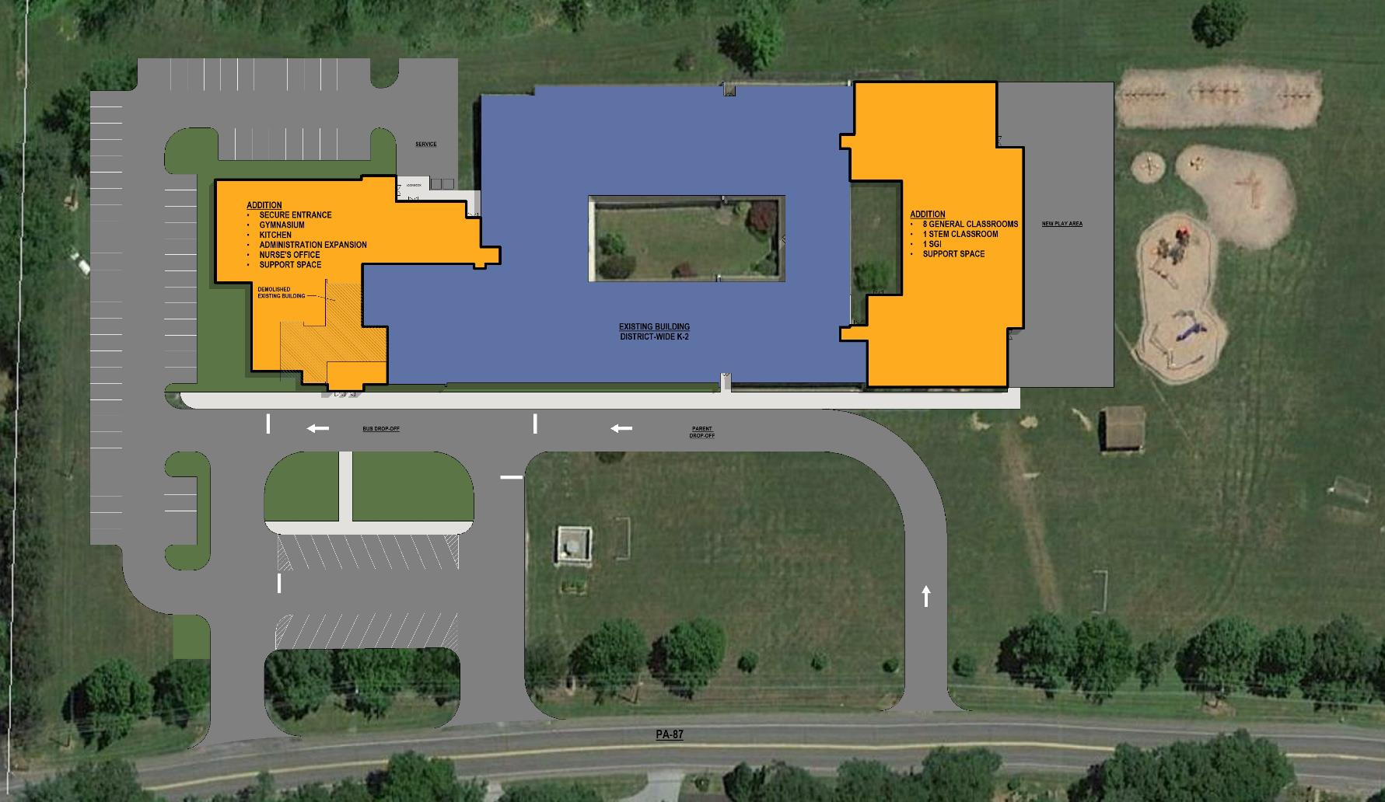
LOYALSOCK VALLEY ES FLOOR PLAN
OPTION 5

Slide 32
OPTION 5
ESTIMATED COSTS

Slide 33
OPTION 5
Pros
Grade groupings align with educational program and goals.
Incorporates 5th grade into an appropriate Elementary grade grouping.
Equity and shared resources among grade levels.
Consolidates district to three buildings creating operational savings.
Cons
3rd and 4th grades located at Middle School.
Increase in transportation time for some Elementary students.
Loss of one neighborhood school.

Slide 34
OPTION 5
At this time the District does not have the borrowing capacity for this project.

Slide 35
OPTION 6
Convert Loyalsock Valley Elementary School to district wide 3-4 Intermediate School
Comprehensive renovations and major additions to Loyalsock Valley Elementary School Convert Lyter Elementary School to district wide K-2 Primary School.
Comprehensive renovations to Lyter Elementary School.

Slide 36
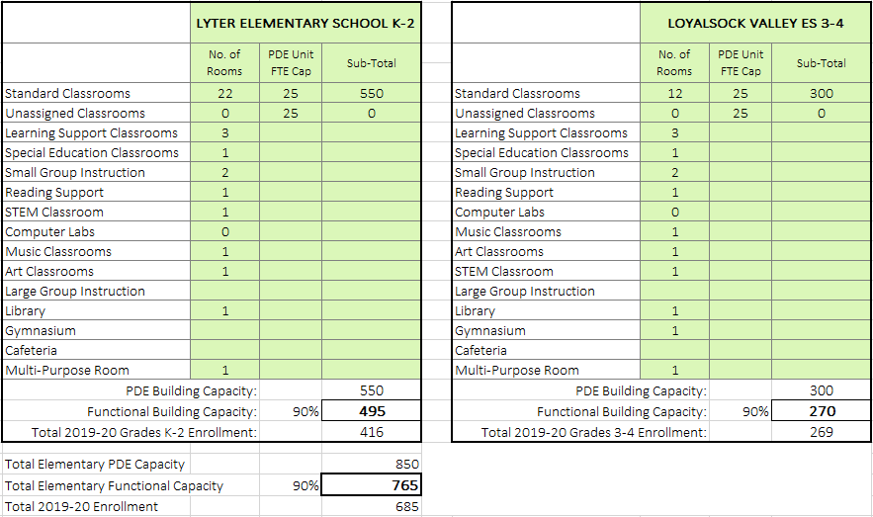
OPTION 6
ELEMENTARY CAPACITY

Slide 37
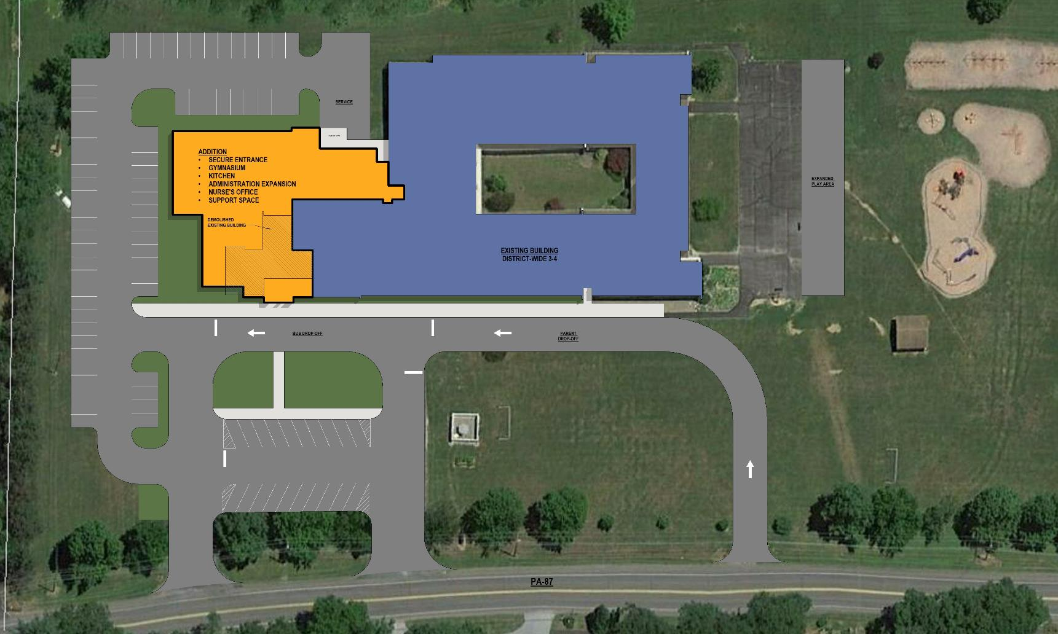
LOYALSOCK VALLEY ES FLOOR PLAN
OPTION 6

Slide 38
OPTION 6
ESTIMATED COSTS

Slide 39
OPTION 6
Pros
Grade groupings align with educational program and goals.
Equity and shared resources among grade levels.
Maintains neighborhood schools.
Cons
Increase in transportation time for all Elementary students.
Increased building transitions for Elementary students.
Transportation difficult for parents with multiple students in district.

Slide 40
OPTION 6
Estimated Significant Savings
Personnel $220,000
$220,000
Estimated Tax Increase Needed to Support Project with Savings
Borrowing $20 Million with $200,000 savings and up to $1.4 Million from Capital
.14mills
.14mills
.15mills
.15mills
.15mills
Total .73mills (This is in addition to any increase needed for operations.)

Slide 41
OPTION 7
Close Loyalsock Valley Elementary School
Close Lyter Elementary School.
Construct new K-4 Elementary School at C.E. McCall Middle School site.
Maintain current grade configuration.

Slide 42
OPTION 7
ELEMENTARY CAPACITY

Slide 43
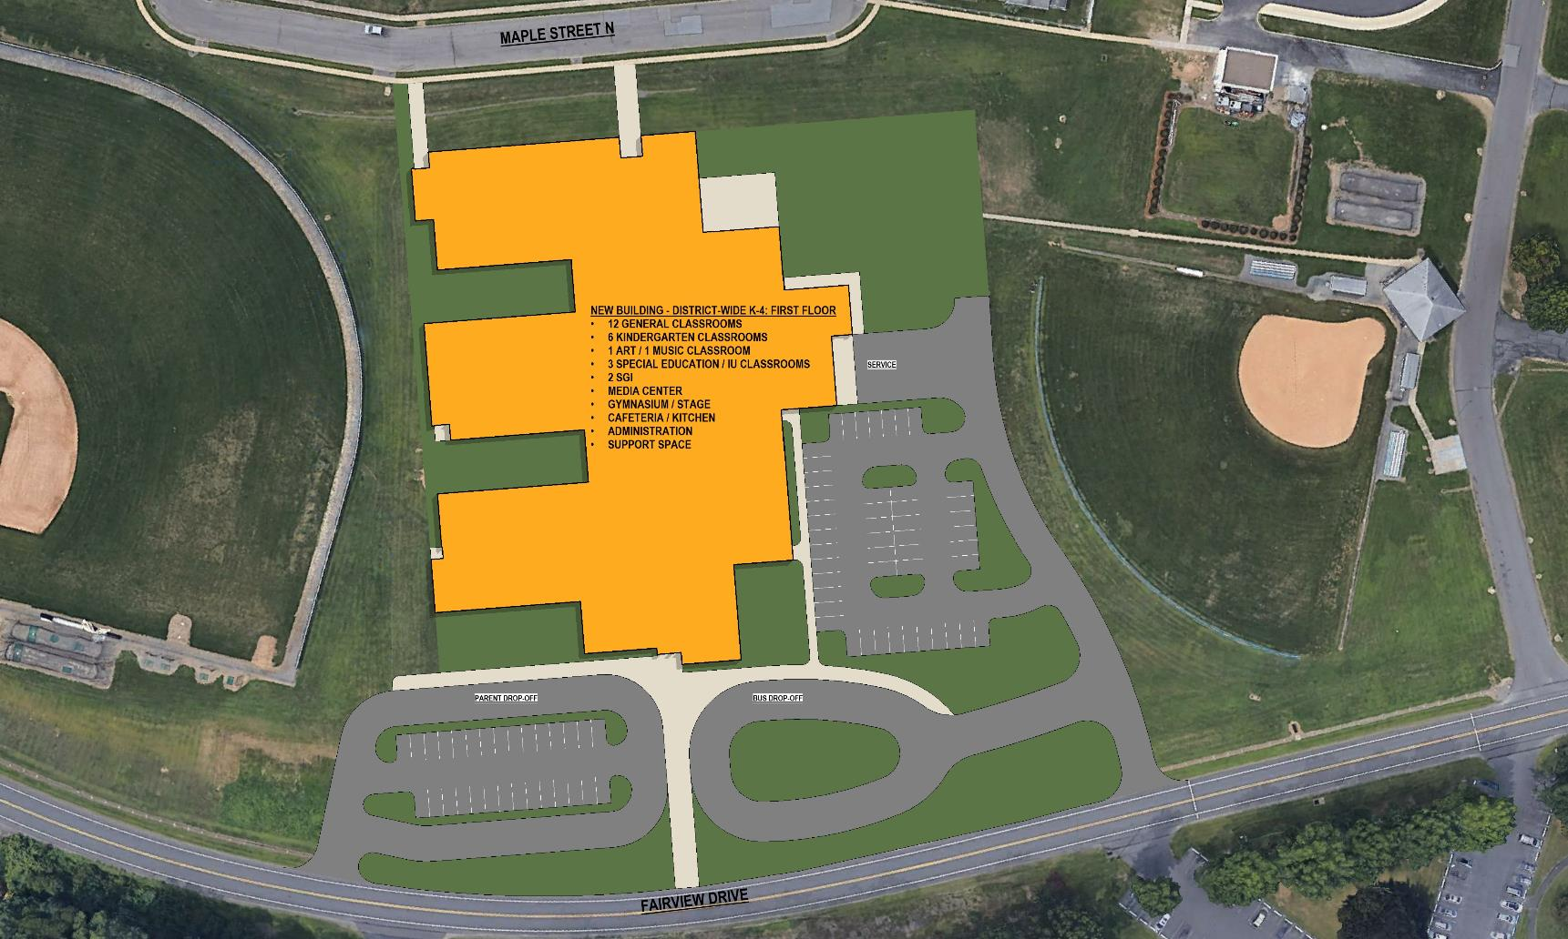
NEW ES FLOOR PLAN
OPTION 7
New Two story K-4 Elementary School

Slide 44
OPTION 7
ESTIMATED COSTS

Slide 45
OPTION 7
Pros
Eliminates infrastructure of older schools.
Equity and shared resources among grade levels.
Consolidates district to three buildings creating operational savings.
Cons
Higher construction cost.
Increase in transportation time for some Elementary students.
Loss of two neighborhood schools.
Eliminates soccer fields.

Slide 46
OPTION 7
Estimated Significant Savings
Personnel $290,000
Maintenance & Utilities $110,000
$400,000
Estimated Tax Increase Needed to Support Project with Savings
Borrowing $25 Million with $400,000 savings and up to $5 Million from Capital
.14mills
.14mills
.14mills
.15mills
.15mills
Total .72mills (This is in addition to any increase needed for operations.)

Slide 47
SUMMARY

Slide 50
Estimated Financial Summary
Option | Amount Borrowing | Capital Being Used | Tax Increase* | Annual Impact on Average Property Assessment | Debt Extended Through
1 | $15,000,000 | $1,000,000 | .74 mills | $95.32 | 2041
2 | $20,000,000 | $0 | .98 mills | $126.24 | 2042
3 | $15,000,000 | $2,000,000 | .36 mills | $46.37 | 2041
4 | $20,000,000 | $4,200,000 | .73 mills | $94.03 | 2042
5 | District does not have the borrowing capacity for this project.
6 | $20,000,000 | $1,400,000 | .73 mills | $94.03 | 2042
7 | $25,000,000 | $5,000,000 | .72 mills | $92.75 | 2043
* Tax increase for just the project. Tax Increases for the general fund are not included in these calculations and will be necessary to maintain normal operations. Millage requirement studies provided by RBC Capital Markets.

