Slide 1
What You Need to Know About Financial Aid

Slide 2
Topics We Will Discuss
Cost of attendance (COA)
Expected family contribution (EFC)
Financial need
Categories, types, and sources of financial aid
Free Application for Federal Student Aid (FAFSA®)
Special circumstances

Slide 3
Free Application for Federal Student Aid (FAFSA®)
Collects demographic and financial information
Information used to calculate the expected family contribution (EFC)
Colleges use EFC to award financial aid
Available in English and Spanish

Slide 4
Free Application for Federal Student Aid (FAFSA®)
For the 2020-21 academic year, the FAFSA may be filed beginning October 1, 2019
Colleges may set FAFSA priority dates
Some schools may require the CSS Profile, or other applications, in addition to the FAFSA. Check school websites to see what is required.

Slide 5
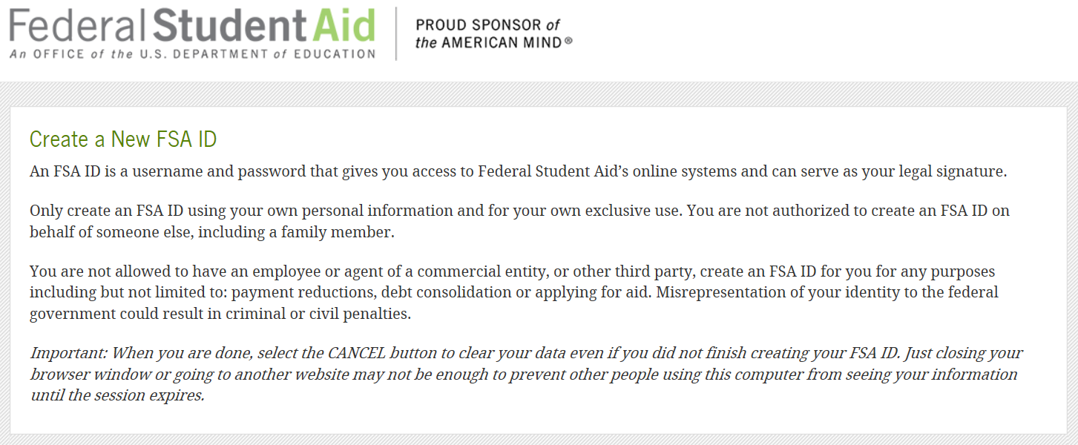
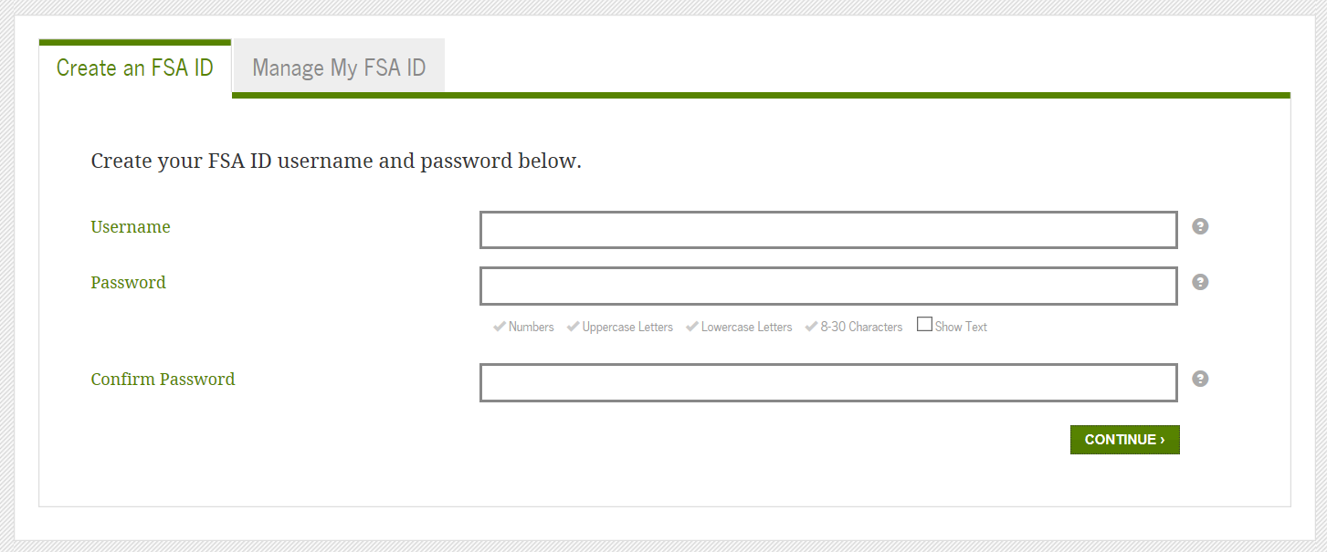
FSA ID
Used for FAFSA completion and allows access to certain U.S. Department of Education websites
May be used by students and parents throughout financial aid process, including subsequent school years
Only the owner should create a FSA ID
Apply at www.fsaid.ed.gov

Slide 6
Where is the FSA ID Used?

Slide 7
FSA ID continued….

Slide 8
Documents Needed for the FAFSA

Slide 9
Fafsa.gov

Slide 10
Apply for the Correct Year

Slide 11
Note the Tabs at the Top…

Slide 12
Use the IRS Data Retrieval Tool if Possible

Slide 13
IRS Data Retrieval Tool

Slide 14
IRS Data Retrieval Tool
Certain tax filers cannot use the
IRS Data Retrieval Tool
Did not indicate on FAFSA a tax return was completed
Marriage date is January 2019, or later
First three digits of the SSN are 666
Filed a non-U.S. tax return
Married and filed as head of household, or filed separate returns
Neither married parent entered a valid SSN
Non-married parent or both married parents entered all zeroes for the SSN

Slide 15
Know how “Assets” are Defined

Slide 16
Don’t Forget to Sign

Slide 17
Don’t forget about PA State Grant…

Slide 18
Frequent FAFSA Errors
Social Security Numbers
Divorced/widowed/remarried parental information
Income earned by parent/stepparent
Untaxed income
U.S. income taxes paid
Household size
Number of household members in college
Real estate and investment net worth

Slide 19
FAFSA Processing Results
CPS
College
Student

Slide 20
Once processed student gets this via email…

Slide 21
And the parent gets this via email…

Slide 22
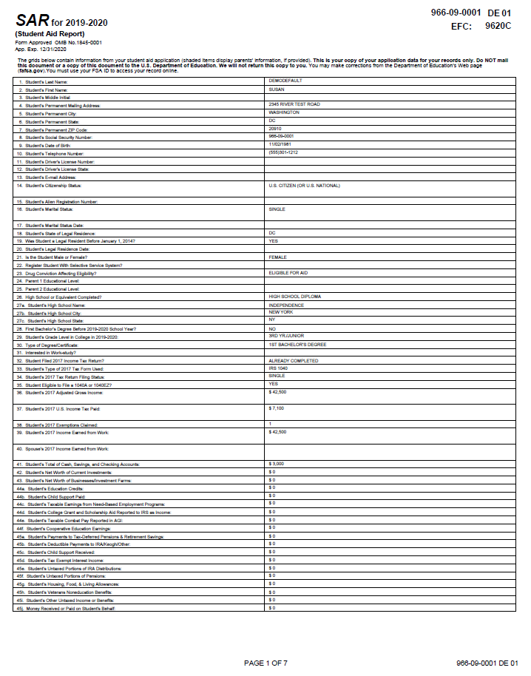
Email Notification of SAR Processing
If valid email address is provided on FAFSA
Provides access to electronic SAR at www.fafsa.gov

Slide 23
What is Expected Family Contribution (EFC)?
Measurement of student’s and family’s ability to pay postsecondary educational expenses
Student contribution
Parent contribution
(for dependent students)

Slide 24
Expected Family Contribution (EFC)

Slide 25
What is Cost of Attendance (COA)?
Tuition and fees
Room and board
Books and supplies
Transportation
Miscellaneous personal expenses

Slide 26
What is Financial Need?
Cost of attendance (COA) – Expected family contribution (EFC) = Financial need

Slide 27
Types of Financial Aid
Scholarships
Grants
Work-Study Employment
Loans
Self-Help Aid
Gift Aid

Slide 28
Sources of Financial Aid
Federal Government
Employers
States
Private Sources
College and Universities

Slide 29
Scholarship Searches on the Web…
www.fastweb.com
www.finaid.org
www.campusexplorer.com
www.collegescholarships.com
www.scholarships.com
www.studentscholarshipsearch.com
www.tuitionfundingsources.com

Slide 30
Special Circumstances
Conditions exist that cannot be documented with the FAFSA
Send written explanation and documentation to your college’s financial aid office
College will review and request additional information if necessary
Decisions are final and cannot be appealed to U.S. Department of Education

Slide 31
Special Circumstances
Secondary school tuition
Unusual uncovered medical/dental expenses
Extraordinary dependent care
Student cannot obtain parental information
Parent or spouse death
Loss of employment
Divorce

Slide 32
Questions…

